Slide 1
Project Title
A Reviewer Recommender System for Scientific Articles Using A New Similarity Threshold Discovery Algorithm

Slide 2
Introductions & Motivation
Related Works
Objectives
Problem Formulation
Proposed System
Experimental Design
Algorithms
Results and Discussion
Future Works
References
Outlines

Slide 3




Introduction & Motivation
A Recommender System
Reviewer Selection
An automated system for reviewer selection

Slide 4
Related Works
Serial Number | Existing Works | Pros | Cons
1 | Manual Selection | Simple to conduct | Fully Dependent on human intelligence
2 | Semi-Automated Selection | Multiple types of data can be collected at the same time | Depends on the choice given by the reviewer
3 | Automated Selection | Does not depends on human intelligence | A few of them are consider confidence factor

Slide 5

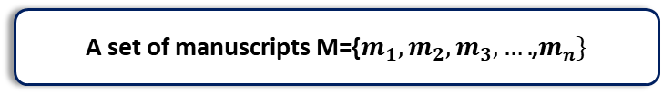
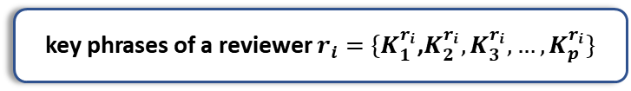

Problem Formulation
A set of manuscripts M={$m_{1},m_{2},m_{3},….$,$m_{n}\}$
A set of reviewers R={$r_{1},r_{2},r_{3},….$,$r_{m}\}$
Key phrases of a manuscript $m_{i}$={$K_{1}^{m_{i}},K_{2}^{m_{i}},K_{3}^{m_{i}},…,K_{p}^{m_{i}}\}$
key phrases of a reviewer $r_{i}=$ ${\{K}_{1}^{r_{i}}$,$K_{2}^{r_{i}},K_{3}^{r_{i}},…,K_{p}^{r_{i}}\}$
Confidence Score
A reviewer confidence score expresses the degree to which a reviewer feels
Articles will be assigned based on similarities more than a discovered threshold
Hypothesis
When similarity index of a reviewer is higher, then the confidence score would be higher

Slide 6
Objectives
01
02
03
To acquire research areas of existing Technical Program Committee members
To develop a recommender system for reviewer selection
To evaluate the proposed reviewer recommender system with existing similar system

Slide 7
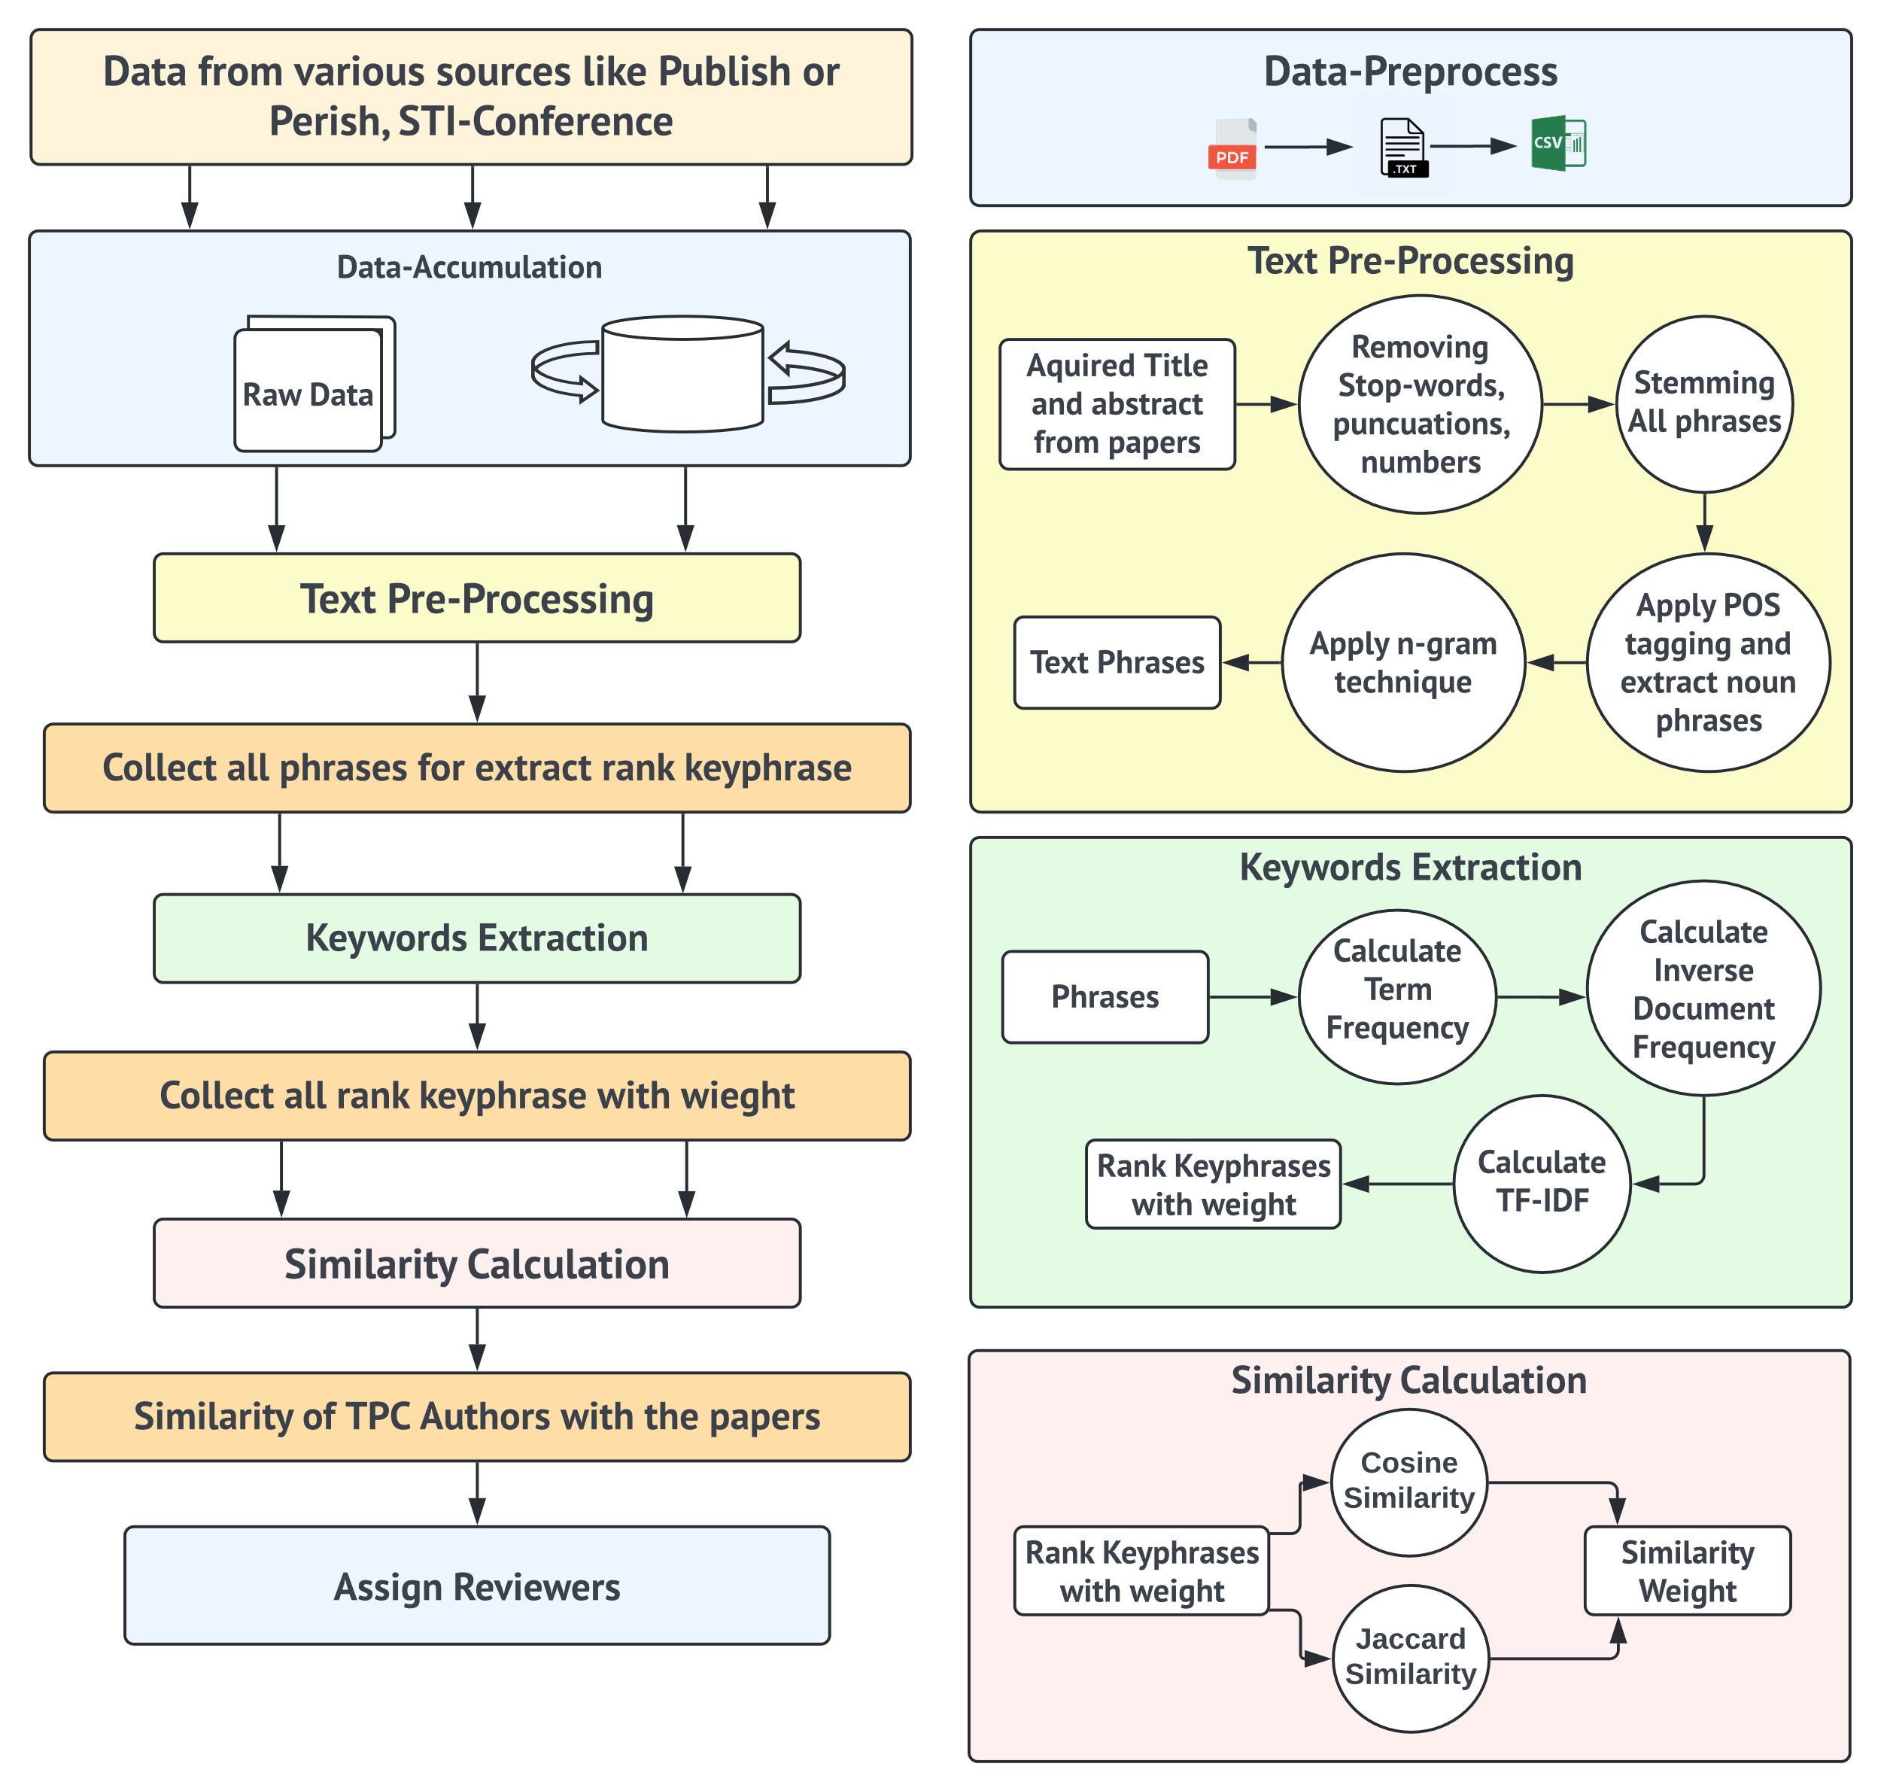
The System

Slide 8
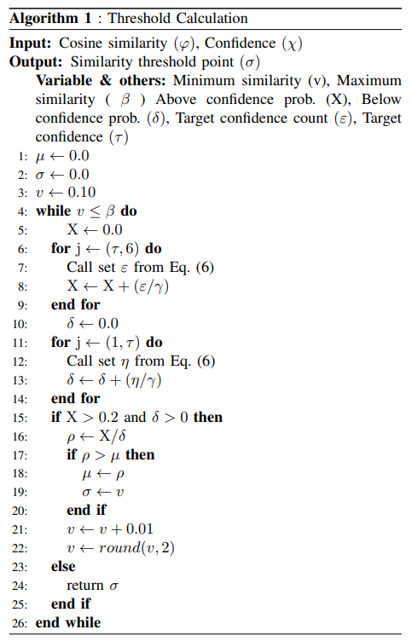
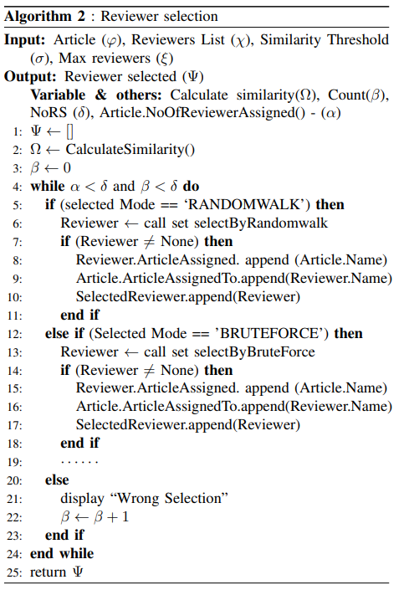
Algorithms

Slide 9
Experimental Design
TPC Authors
Papers
STI-conference 106 members
STI-conference TPC paper and submitted papers
Author Citation Metrics
TPC Authors
Interests
TPC Authors Confidence
Papers
STI Paper
Collect Data like h-index, g-index and paper citation
Collect Data authors interest fields
Collected TPC authors confidence for STI papers
Collect full paper of each authors last 10 year
Collect full papers of STI-conference 2021

Slide 10
Implementation Details of the proposed technique
Import library
Choose Column
Data Cleaning
Insertion
Title, Abstract column
PorterStemmer, Punctuation, Number, Stop words, POS
Pandas, Numpy,
OS, NLTK, String, itertools
File Insert
Threshold
Identification
Assigning Articles
Cosine Similarity
Apply RandomWalk, Bruteforce, RandomBruteforce, Mixed_RB, Mixed_RR
Apply Threshold
Algorithm
Apply TF -IDF
TF - IDF
Jaccard Similarity

Slide 11
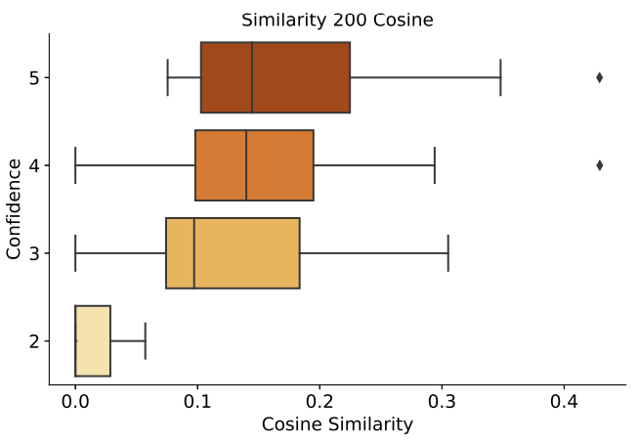
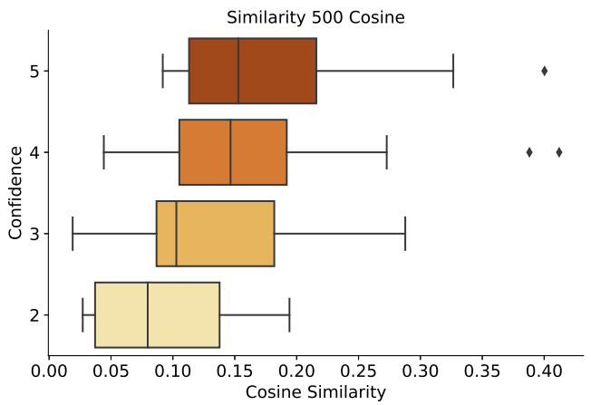
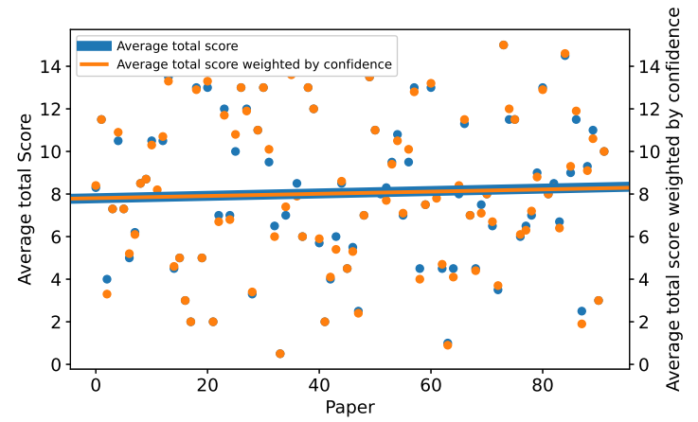
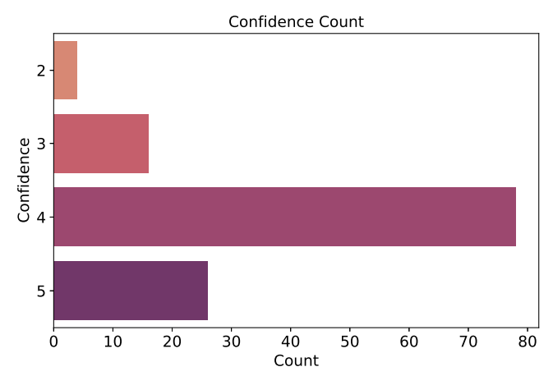
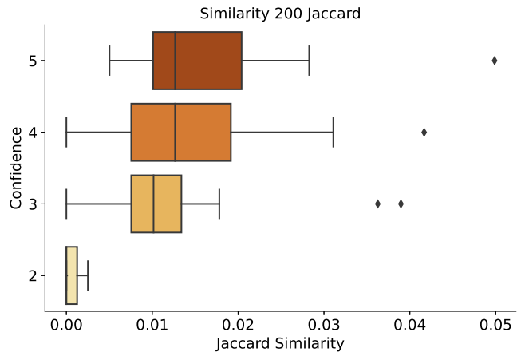
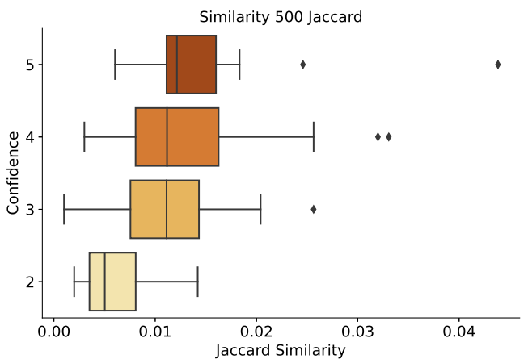
Experimental Result(Proof of the Hypothesis)

Slide 12
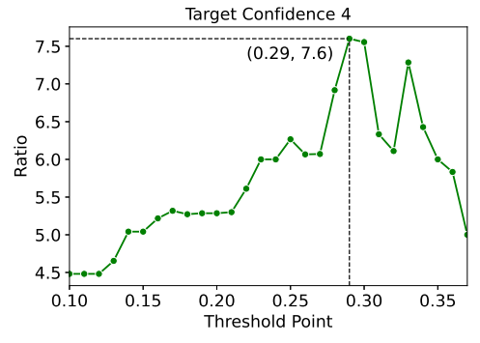
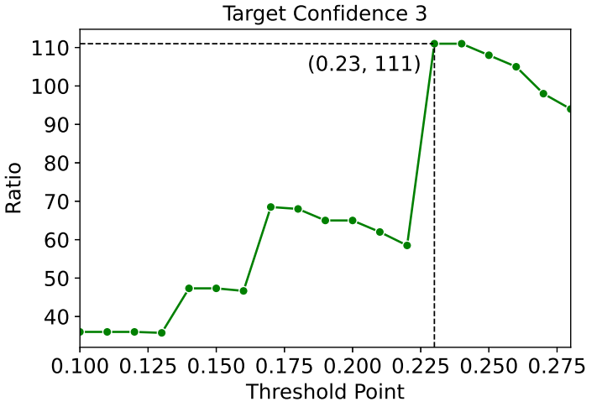
Result Threshold
Fig. 1: Target Confidence 4 threshold point
Fig. 2: Target Confidence 3 threshold point

Slide 13
Reviewer Assigned (Result)
Selection Techniques | Assigning reviewers for articles
 | 0 | 1 | 2 | 3 | 4
Random Walk | 5.26% | 7.01% | 10.52% | 10.52% | 66.66%
Brute Force | 3.50% | 8.77% | 8.77% | 7.01% | 71.92%
RandomBruteForce | 3.50% | 7.01% | 7.01% | 12.28% | 70.17%
Mixed - RB | 8.77% | 3.50% | 10.52% | 5.26% | 71.92%
Mixed - RR | 5.26% | 12.28% | 1.75% | 8.77% | 71.92%
Selection Techniques | Assigning articles for reviewers
 | 0 | 1 | 2 | 3
Random Walk | 0% | 7.46% | 7.46% | 85.07%
Brute Force | 0% | 2.98% | 8.95% | 88.05%
RandomBruteForce | 1.49% | 0% | 7.46% | 91.04%
Mixed - RB | 2.98% | 2.98% | 5.97% | 88.05%
Mixed - RR | 1.49% | 2.98% | 8.95% | 86.57%
Table 1: Statistics of article assignment
[67 Manuscripts]
Table 2: Statistics of reviewer assignment
[57 Reviewers]

Slide 14
Conclusion & Future Works
Construct a new dataset.
Implement a new and better algorithm.
Optimize the ready algorithm.
Similarity and confidence relationship.
Evaluate the existing similar systems.
KeyPhrase extraction techniques
Tf-Idf
Metaheuristic
Hyper heuristic
Rake
Spacy
Yake
Textrank
KeyPhrase extraction techniques
Optimization algorithm

Slide 15
Thank You for
Your valuable time
To Visit
My Presentation

